Slide 1

Vectrofy
SCHOOL OF TECHNOLOGY,DESIGN AND COMPUTER APPLICATION
Team Members Name
Falgun Sorathiya
Om Patel
Nishith Mehta
Naman Umraniya
Jaydeep Solanki
Guide- Prof. Trishir Wadbude Department-BCA

Slide 2

Objectives of the Project
Raster to Vector Conversion
Cloud Storage Integration
User-Friendly Interface
Editability and Customization
Image Analysis & Processing

Slide 3
Abstract
Vectrofy is an innovative tool that converts raster images like PNG or JPG into scalable vector graphics (SVG). Unlike pixel-based raster images that lose quality when resized, vector graphics use mathematically defined shapes, lines, and curves, allowing them to scale infinitely without losing sharpness or clarity. This makes Vectrofy ideal for creating visuals that work across all dimensions, from tiny icons to massive Billboards.
By leveraging advanced algorithms, Vectrofy analyzes the colors, shapes, and details in raster images to create precise vector representations using Bézier curves, paths, and polygons. The software preserves the original image’s essence while offering scalability, editability, and design flexibility. As demand for efficient, high-quality graphics grows, Vectrofy empowers professionals to streamline workflows and optimize designs with ease.

Slide 4
Literature Review/Related Work
Papers | Insights | Objectives | Abstract | Literature Survey
Optimize &amp; Reduce: A Top-Down Approach for Image Vectorization Author: [Hirschorn, Amir Jevnisek, Shai Avidan] | The paper presents Optimize & Reduce (O&R), a top-down algorithm for efficient raster-to-vector conversion, optimizing Bezier curves while reducing shapes for faster, high-quality, and compact vector representation. It achieves 10x faster speed than state-of-the-art methods. | The research aims to develop Optimize & Reduce (O&R), a fast, domain-agnostic vectorization method that optimizes Bezier curves to achieve compact image representation with fewer shapes and high-quality reconstruction. | The paper introduces Optimize & Reduce (O&R), a fast, domain-agnostic vectorization method that optimizes Bezier curves to achieve compact, high-quality image representation with fewer shapes, outperforming existing methods. | The literature review covers traditional image vectorization, involving pixel clustering via segmentation or triangulation and optimizing vector primitives' number and position for improved efficiency.
Statistical based vectorization for standard vector graphics Author: [Sebastiano Battiato, Giovanni Maria Farinella, Giovanni Puglisi] | The paper presents a novel algorithm for raster to vector conversion, utilizing advanced segmentation based on statistical region analysis and heuristics for boundary tracking, outperforming existing methods like Vector Eye, SWaterG, SVGenie, and SVGWave in quality and image size. | Develop a novel algorithm for raster to vector conversion. Enhance photorealistic appearance for human visual perception. | Algorithm for raster to vector conversion with photorealistic appearance. Uses statistical region analysis and heuristics for boundary tracking. | Brief review of main details of SRM. Discusses boundary representation computation methods.

Slide 5
Literature Review/Related Work
Papers | Insights | Objectives | Abstract | Literature Survey
Vectorization of Raster Images Using B-Spline Surfaces Author: [Curtis A. Armstrong] | The paper describes a vectorization process that utilizes B-Spline surfaces for converting raster images to vector graphics. It employs least-squares approximation to fit B-Splines to image colors, optimizing editability and minimizing control points for efficient representation. | Convert raster images into vector images using B-Spline surfaces. Approximate segment boundaries and interiors with B-Spline curves. | Converts raster images into vector images using B-Spline surfaces. Segments images, approximates boundaries with periodic B-Spline curves. | Early systems converted black-and-white line drawings to vector images. Coons surfaces are ideal for geometry approximation in vectorization.
Im2Vec: Synthesizing Vector Graphics without Vector Supervision Author: [Pradyumna Reddy, Michaël Gharbi, Michal Lukáč] | The paper presents Im2Vec, an efficient algorithm for converting raster images to vector graphics using image supervision alone. It outperforms methods like SVG-VAE and DeepSVG, which rely on vector supervision, by achieving superior reconstruction fidelity. | Generate complex vector graphics without explicit vector supervision. Support reconstruction, sampling, and interpolation of vector elements. | Neural network generates vector graphics from raster images indirectly. Overcomes need for explicit vector supervision in training. | Focus on deep learning for parametric vector shapes. Previous works require direct vector supervision for training.

Slide 6
Methodology
User
MongoDB
(User Data, Images)
- Store User Details
- Store Image file
Image Conversion
(Flask)
- Convert PNG/JPG to SVG
- Adjustable Threshold
User Interaction (Upload Image, Sign Up/Sign In)
Backend
(Express & Node.js)
- API for image upload
- API for authentication
Download Image
Front-End (React)
6

Slide 7
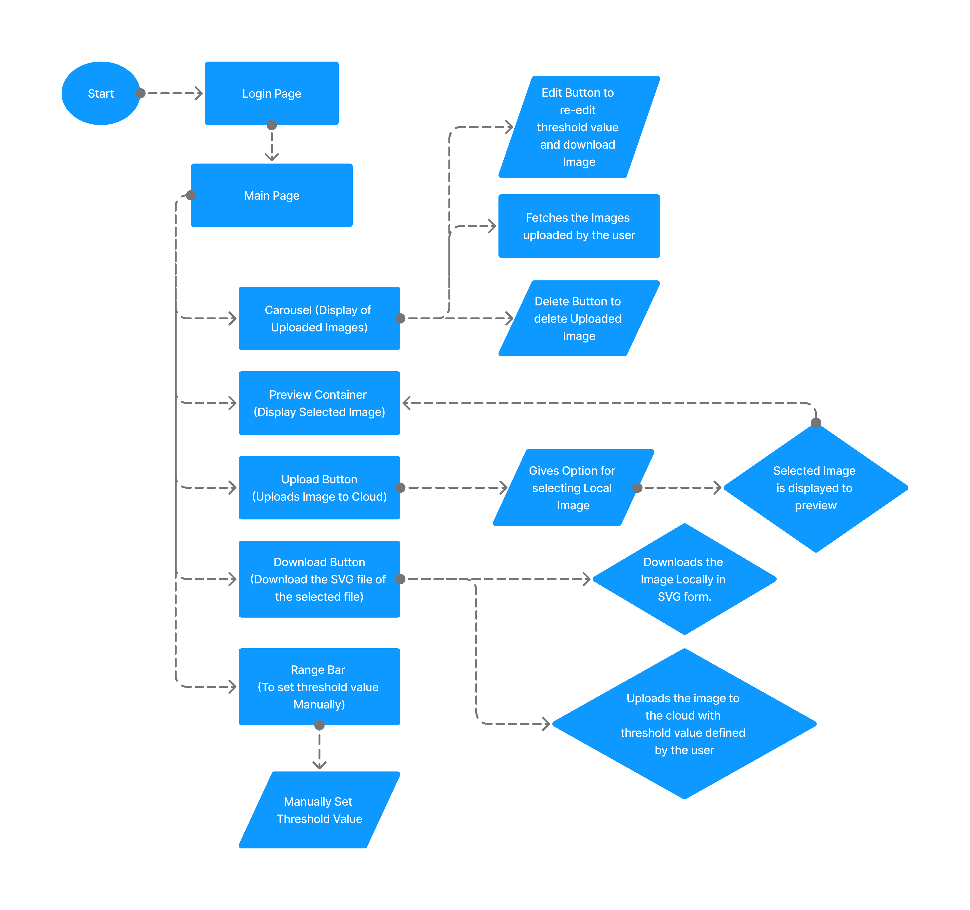
System Design/Architecture
Start: Open the web app
Login: When Opening the web application, user gets redirected to login page if not authenticated.
Main Page: It includes all the functionalities and features of this application.
Carousel: It displays all the previous images uploaded by the user. Vectrofy stores images uploaded by the user on cloud.

Slide 8
System Design/Architecture
Preview Container: It displays the image uploaded or selected by the user.
Upload Button: It is used to let the user select any image from there local storage.
Download Button: It is used to download the converted image locally in the computer.
Range Bar: It lets users select the intensity/ threshold for image conversion.

Slide 9
Development Process
Requirement Analysis
Frontend Development
Model Integration
System Design
Backend Development
Algorithm Development
Model Testing
9

Slide 10
Future Scope
Enhanced Vector Conversion Options: Add support for advanced vector formats, including line art and gradient-based vectors.
Integration with Design Tools: Provide direct export options to popular design tools like Adobe Illustrator, Figma, and Canva.
Offline Functionality: Offer an offline version of the app where users can perform conversions without requiring internet access.
Subscription Plans and Monetization: Offer premium features through subscription plans, such as higher storage limits and faster processing.

Slide 11
RESULT AND EVALUATION
Feature | Vectrofy | Adobe Illustrator | CorelDRAW | Inkscape
Ease of Use | Simple, user-friendly interface with no steep learning curve. | Professional-grade tools with a steep learning curve. | Professional-grade, requires training or experience. | Moderate learning curve, suitable for experienced users.
Free to Use | Free or offers affordable pricing tiers. | Requires paid subscription (Creative Cloud). | Requires a paid license. | Free and open-source.
No Installation Needed | Web-based application accessible via any browser; no installation required. | Requires installation on a local device. | Requires installation on a local device. | Requires installation on a local device.
Cloud Integration | Integrated cloud storage for uploading, storing, and reprocessing images anytime. | Available but only as part of a paid Creative Cloud subscription. | Limited or no cloud features by default. | No built-in cloud integration; requires plugins.
Accuracy | High-quality automated raster-to-vector conversion with colored vector output. | Manual raster-to-vector conversion tools available. | Manual raster-to-vector conversion tools available. | Offers basic conversion tools, but requires manual adjustments.

Slide 12
References
[1] S. Schwarzmüller, "React, NodeJS, Express & MongoDB - The MERN Fullstack Guide," Udemy. [Online]. Available: https://www.udemy.com/course/react-nodejs-express-mongodb-the-mern-fullstack-guide/..
[2] "Redux Crash Course | React Redux Tutorial," YouTube, 2024. [Online]. Available: https://youtube.com/watch?v=1i04-A7kfFI&t=3245s.
[3] "How to Upload Image to Cloudinary in React," YouTube, 2024. [Online]. Available: https://www.youtube.com/watch?v=YH63fnqG7F0&t=1s.
[4] "Raster to Vector Conversion Tutorial," YouTube, 2024. [Online]. Available: https://youtu.be/i_9tAee-hYo?si=snPzcD_ujSKaS7TU.
[5] "Flask Tutorial - Python Web Framework," GeeksforGeeks. [Online]. Available: https://www.geeksforgeeks.org/flask-tutorial/.

Slide 13
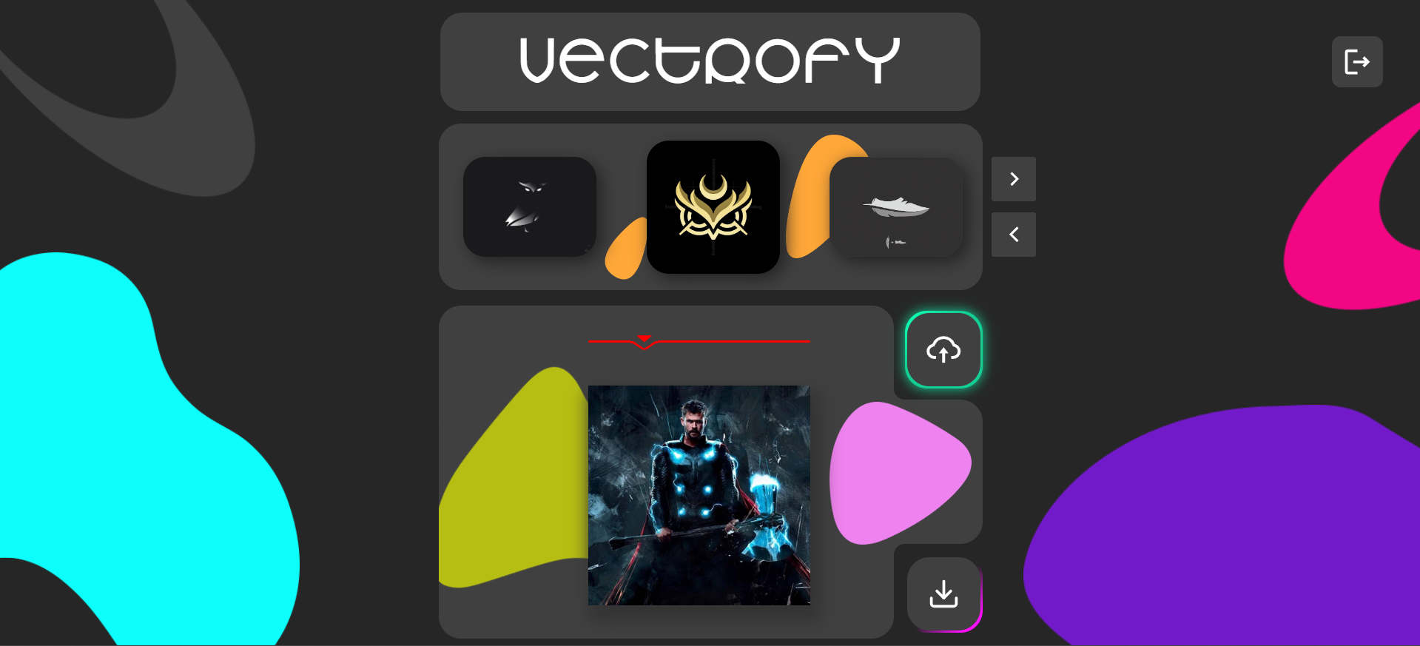

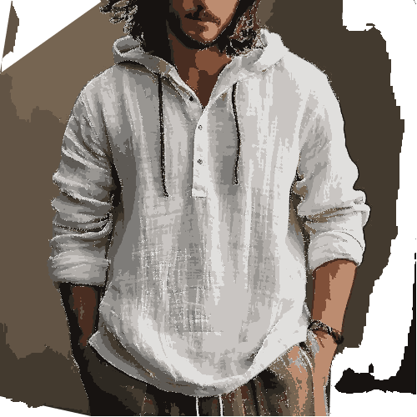
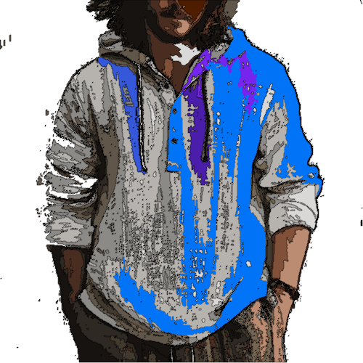
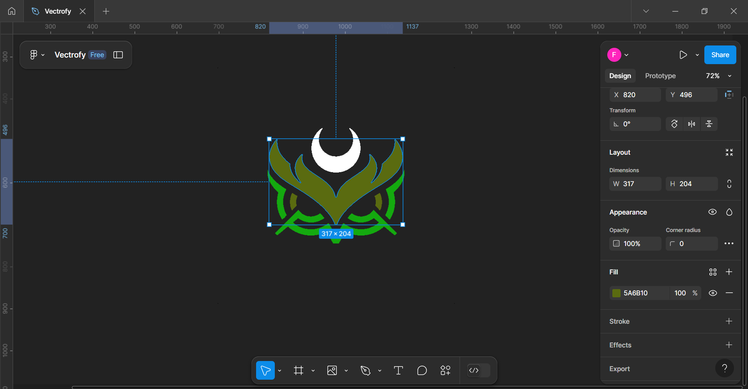
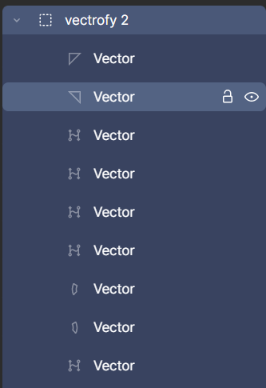
Related Photographs
Input
Output
After Editing

Slide 14
Thank You

